Slide 1

Video Recording

Slide 2

Module 05_Project 01_DSE 5002 R and Python Programming
Class: DSE 5002: R & Python Programming
Semester: Fall 2024
Prepared by: Anthony V. Razzano, DHA
Notes:
Hello, I am Anthony Razzano, and this is the presentation for project 1 within the DSE 5002 R and Python programming course at Merrimack College.

Slide 3
Background
The CEO of your company has decided to hire a full-time data scientist, with the potential to build a future team. She is unsure of the appropriate salary range due to wide variations in global pay, coupled with rising wages caused by the economic recession and a competitive job market. She requests an analysis of data science salaries to establish a competitive range, particularly comparing the U.S. and offshore markets.
The company is small but rapidly growing, and the role can be remote. The CEO expects a presentation with visuals to communicate salary recommendations, and the R code should be delivered as a flat file for submission.
Metadata for the analysis includes: - Work year, experience level, employment type, job title - salary details (total and in USD), employee residence - remote work percentage, company location, and company size (small, medium, large)
The deliverables include: A PowerPoint presentation for the CEO with visualizations and analysis. An R script for the analysis but without showing code in the presentation.
Notes:
This slide includes a brief summary of the assignment background. The CEO of a rapidly growing company is seeking to hire a full-time data scientist, with the potential to expand into a team. Given wide variations in global pay and a competitive job market, the CEO requested an analysis to establish a competitive salary range, focusing on U.S. and offshore comparisons. The role is remote, and the presentation is expected to include salary recommendations based on the analysis.

Slide 4
Pre-Analysis Steps
Meet with internal stakeholders
Identify business questions
Collect data
Identified and extracted dataset, stored internally in secure and ethical file location
Data preparation
Converted relevant columns, checked for missing values, assessed data to gain foundational exploration knowledge
Reference(s):
(Lin et al., 2022)
(Schick et al., 2022)
Notes:
Some pre-analysis steps are to be taken. First, by meeting with internal stakeholders to define key business questions. Recent advancements in technology improve the ability to capture, store, and communicate data to improve the speed of data analysis (Schick et al., 2022). Data was collected and securely stored, with ethical considerations in mind. During the preparation phase, relevant columns were converted, missing values were addressed, and exploratory data analysis was conducted. Unstructured data from various sources requires alterations to make it useful for analysis, and the tools and methods required to achieve this is called data preparation and cleaning (Lin et al., 2022).

Slide 5
Exploratory Data Analysis
Exploratory data analysis
Salary Distribution by Experience Level (Boxplot)
Average Salary by Company Location, US vs Offshore, (Barplot)
Correlation Analysis Between Numerical Variables (Bivariate)
Remote Work Ratio vs Salary (Barplot)
Salary Distribution by Company Size (Boxplot)
Average Salary by Job Title (Barplot)
Clustering (Unsupervised Learning, K-Means)
Hypothesis Testing (T-Test)
Reference(s):
(Komorowski et al., 2016).
Notes:
Next, an exploratory data analysis was conducted. Exploratory data analysis (EDA) is a crucial step in research, where data is visualized, plotted, and explored without assumptions to assess its quality and guide model building, with a strong emphasis on graphical techniques for deeper insights (Komorowski et al., 2016). The following types of analysis were completed based on the data.

Slide 6
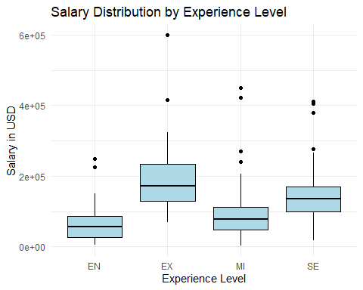
Salary Distribution by Experience Level
Exploratory Data Analysis Type: Boxplot
Takeaways
Salaries increase with experience level
Entry-Level (EN) positions show the lowest median salaries
Executive-Level (EX) positions have the highest median salaries
Strong correlation between experience and salary levels, reflecting a competitive employment environment where more experienced individuals command higher pay
Reference(s):
(Hong et al., 2013)
Notes:
A boxplot is a useful tool for retaining population information by representing key aspects of the data distribution, such as percentiles, the robust minimum and maximum, variance, confidence regions, and outliers, offering a concise visual summary of scalar-valued data (Hong et al., 2013). Salary distribution across different experience levels visualized with boxplot. Visual reveals that salaries increase with experience; entry-level (EN) positions show the lowest median salaries. Executive-level (EX) positions had the highest; This suggests a strong correlation between experience and salary levels, which sounds accurate within the competitive employment environment; more experienced individuals tend to command higher pay.
A boxplot demonstrates that salaries increase with experience. Entry-level positions have the lowest median salaries, while executive-level positions show the highest, highlighting the strong correlation between experience and salary.

Slide 7
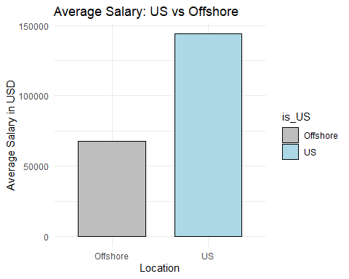
Average Salary Comparison: U.S. vs. Offshore
Exploratory Data Analysis Type: Bar Plot
Takeaways
U.S.-based salaries are significantly higher than offshore salaries
Difference: U.S. salaries are over 50% higher than offshore salaries
Indicates a geographical disparity in salary expectations
Reference(s):
Notes:
Bar plots are useful to highlight intervals or counts related to comparable measures, and are commonly used and easy to interperate (Paley et al., 2024). Comparison of average salaries between U.S.-based and offshore employees illustrated through a bar plot. The bar plot indicates that U.S. salaries are significantly higher than those of offshore employees, over 50% higher. The result highlights a geographical disparity in salary expectations.
A bar plot compares the average salaries between U.S.-based and offshore employees, showing U.S. employees earn over 50% more on average, indicating a clear geographical disparity in salary expectations.

Slide 8
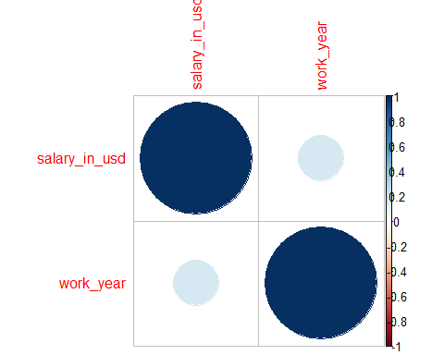
Correlation Analysis: Salary vs. Work Year
Exploratory Data Analysis Type: Correlation Plot
Takeaways
Visual reveals a weak correlation between salary and work year
Results indicates that other factors are likely more significant in determining salary levels than work year alone
Reference(s):
(Hazra & Gogtay, 2016)
Notes:
Correlation measures the strength of the linear relationship between two variables, expressed as a correlation coefficient (Hazra & Gogtay, 2016). Correlation plot used to examine the relationship between salary and work year. The analysis shows a weak correlation between these two variables, suggesting that factors other than work year are likely more influential in determining salary levels.
A correlation plot reveals a weak correlation between salary and work year, suggesting that other factors play a more significant role in determining salary levels.

Slide 9
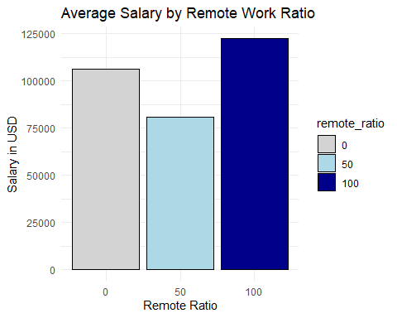
Analysis of Remote Work Ratio and Salary
Exploratory Data Analysis Type: Bar plot
Takeaways
Fully remote positions (100% remote) tend to offer the highest salaries
Companies providing remote work opportunities may attract higher-paid talent
Reference(s):
(Costin et al., 2023)
Notes:
Barplot was used to analyze the relationship between the remote work ratio and salary. The results revealed that fully remote positions (100% remote) tend to have the highest salaries, suggesting that companies offering remote work opportunities may attract higher-paid talent. A barplot illustrates that fully remote positions tend to offer the highest salaries, indicating that companies offering remote work can attract higher-paid talent.The COVID-19 pandemic created a massive transition to remote work, and in the post-pandemic job market, many employers are continuing to use remote work to attract talent globally (Costin et al., 2023).

Slide 10
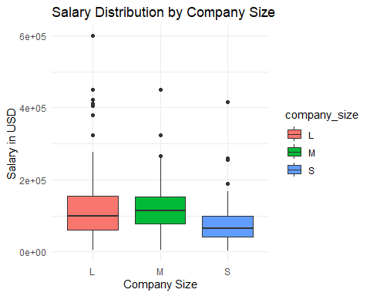
Salary Distribution by Company Size
Exploratory Data Analysis Type: Boxplot
Takeaways
Larger companies (L) offer higher salaries compared to medium (M) and small (S) companies
Company size is a significant factor in salary determination
Reference(s):
(Linden et al., 2023)
Notes:
The distribution of salaries by company size performed through a boxplot. The result revealed that larger companies (L) tend to offer higher salaries compared to medium (M) and small (S) companies, highlighting that company size is a notable factor in salary determination.
A boxplot shows that larger companies offer higher salaries compared to medium and small companies. Company size proves to be an important factor in salary determination. Many large companies offer higher pay to remain competitive and sustain in competitive industries (Linden et al., 2023).

Slide 11
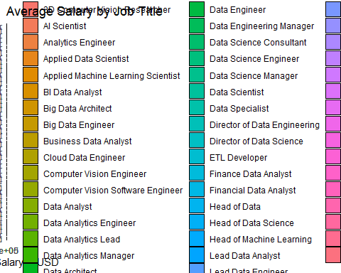
Salary Variation by Job Title
Exploratory Data Analysis Type: Bar plot (flipped coordinates for readability)
Takeaways
Significant salary differences across job titles
Roles such as Principal Data Scientist and Director of Data Science command the highest salaries
Reference(s):
(Kim et al., 2020)
Notes:
Bar plots are one of the most common and easily created plots because they can be readily made in Excel (Kim et al., 2020). A bar plot, with flipped coordinates for readability, highlights significant salary differences across job titles. Positions like Principal Data Scientist and Director of Data Science command the highest salaries.

Slide 12
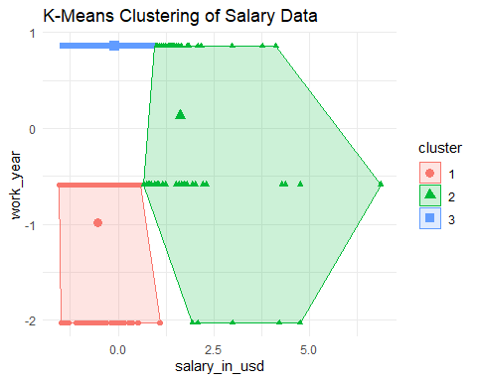
K-Means Clustering Analysis
Exploratory Data Analysis Type: Clustering
Takeaways
Reveals 3 clusters based on salaries in natural groupings
Effective for implementing salary strategy or evaluation
Reference(s):
(Chen & Witten, 2023)
Notes:
Testing for differences in means between two groups is a fundamental statistical task with various applications, and while classical hypothesis tests effectively control the Type I error rate for pre-specified groups, there is a growing trend to assess differences in means among groups defined by observed data, such as those identified by clustering algorithms (Chen & Witten, 2023).
Clustering analysis reveals three distinct salary clusters, providing insights into natural groupings in the data. This segmentation offers valuable insights for salary strategies.

Slide 13
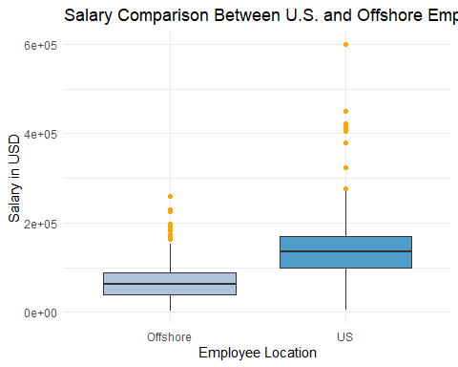
Hypothesis Testing
Exploratory Data Analysis Type: Hypothesis Testing, T-Test
Takeaways
U.S. employees have higher average salaries than offshore
T-Statistic: 16.685, indicating a large difference
P-Value: Less than 2.2e-16, confirming statistical significance
Reference(s):
(Mishra et al., 2019)
Notes:
The paired samples t-test, also known as the dependent samples t-test, is used to assess whether the mean difference between two paired observations is statistically significant, relying on continuous and normally distributed paired variables measured at two time points or through two different methods, and requires the calculation of the mean and standard deviation of the paired differences along with the sample size to determine significance levels (Mishra et al., 2019). The t-test comparing U.S. and offshore salaries resulted in a t-statistic of 16.685, with a p-value less than 2.2e-16, confirming a significant difference. U.S. employees earn considerably more than offshore employees.

Slide 14
Predictive Analytics
Predictive Analytics
Linear Regression
Random Forest Model
Support Vector Machine Model
Reference(s):
(Anderson et al., 2024)
Notes:
In addition to the exploratory data analysis, predictive analytics were leveraged to further improve the analysis. Predictive analytics involves using statistical techniques, machine learning algorithms, and historical data to forecast future outcomes or behaviors (Anderson et al., 2024). The following were conducted:

Slide 15
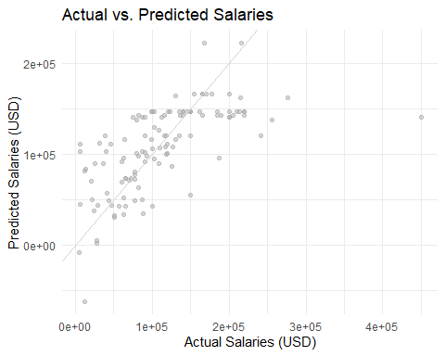
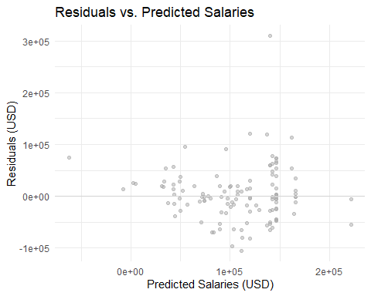
Linear Regression
Predictive Analytics: Linear Regression
Actual vs. Predicted Salaries
Predicts salaries based on experience level, employment type, remote work ratio, company location, and company size
Residuals vs. Predicted Salaries
Residuals represent the error or the difference between actual and predicted salaries
Residuals plot shows large deviations in some cases, indicating that factors not included in the model may significantly influence salaries
Reference(s):
(Schneider et al., 2010)
Notes:
Regression analysis is a crucial statistical technique for analyzing medical data, as it helps identify and characterize relationships among various factors, discover prognostically significant risk factors, and calculate risk scores for individual prognosis (Schneider et al., 2010). For Actual vs. Predicted Salaries, the model predicts salaries based on factors like experience level, employment type, remote work ratio, company location, and company size. There are noticeable deviations between actual and predicted salaries, suggesting the model captures some important salary determinants but leaves some variability unexplained. Experience level and employment type are the most significant predictors, with executive roles driving higher salaries.
For, Residuals vs. Predicted Salaries, the residuals represent the error or the difference between actual and predicted salaries. Residuals plot shows large deviations in some cases, indicating that factors not included in the model may significantly influence salaries. The model explains about 49% of salary variability, with remaining variation possibly due to unaccounted factors like individual performance or company-specific policies.
In summary, the linear regression model, which predicts salaries based on experience level, employment type, remote work ratio, company location, and company size, showed some large deviations, indicating that not all significant factors were captured in the model.

Slide 16
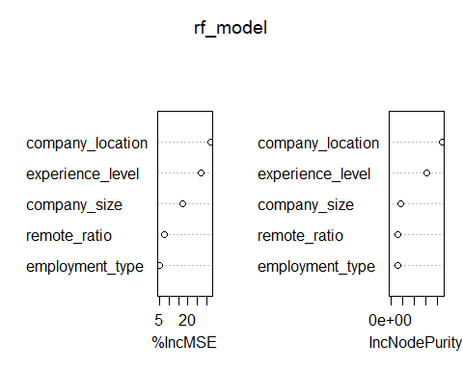
Random Forest Model Performance
Predictive Analytics: Random Forest
Takeaways
Performed well in predicting salaries based on the available data
Lower RMSE indicates that the model's predictions are closer to the actual salary values
Reference(s):
(Hu & Szymczak, 2023)
Notes:
In longitudinal studies, where variables are repeatedly measured over time resulting in clustered and correlated observations, machine learning techniques like the effective random forest (RF) offer promising alternatives to traditional statistical methods, particularly when dealing with high-dimensional data for prediction model development (Hu & Szymczak, 2023). The Random Forest model performed sufficiently; it achieved an RMSE of 56,236.54 on the test data, identifying experience level and employment type as the most important variables in predicting salary. The Random Forest model outperformed others, with lower error rates, making it the best model for predicting salaries. Experience level and employment type were identified as the most important predictors.

Slide 17
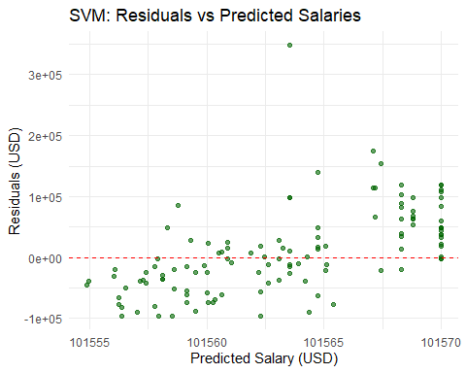
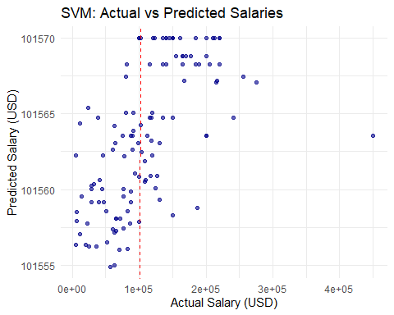
Support Vector Machine (SVM) Model Analysis
Predictive Analytics: Support Vector Machine
Actual vs. Predicted Salaries
Indicates average error in predictions, suggesting lower accuracy for salary prediction
Residuals Plot
Wide range of residuals indicates substantial prediction errors
Results indicate this model is not sufficient to draw conclusions
Reference(s):
(Huang, 2018)
Notes:
Support vector machine (SVM) learning, which focuses on maximizing the separating margin (vector), is a robust classification tool that has been applied in various settings, such cancer genomic classification and subtyping, to generate vast amounts of data in classifying capabilities to facilitate new discoveries (Huang, 2018). The SVM model produced higher error rates, showing less accuracy in salary prediction, making it less effective for this analysis.

Slide 18
Executive Summary
Takeaways
Experience level influences salary; more experienced professionals earn higher wages
U.S.-based employees earn more than offshore employees; there is clear geographical disparity
Larger companies offer higher salaries than small and medium-sized firms
Fully remote positions are linked to higher salaries; offering remote work can attract top talent
Recommendations
Prioritize experience level and full-time roles in salary decisions
Offer remote work options to attract top talent
Plan for higher salary costs in the U.S. while leveraging offshore opportunities for cost efficiency
Reference(s):
Notes:
The analysis showed that experience level significantly affects salary, with more experienced professionals earning more. U.S.-based employees earn more than offshore counterparts, and larger companies offer higher salaries. Fully remote roles tend to offer higher salaries, which suggests that offering remote work may attract higher-paid talent. It is recommended that the company prioritize experience level and full-time roles when making salary decisions, consider offering remote work to attract top talent, and plan for higher salary costs in the U.S. while leveraging offshore opportunities for cost efficiency.

Slide 19
References
Anderson, E., Lennon, M., Kavanagh, K., Weir, N., Kernaghan, D., Roper, M., Dunlop, E., & Lapp, L. (2024). Predictive data analytics in telecare and telehealth: A systematic scoping review (preprint). Online Journal of Public Health Informatics, 16, Article e57618. https://doi.org/10.2196/57618
Chen, Y., & Witten, D. (2023). Selective inference for k-means clustering. Journal of Machine Learning Research, 24. https://pubmed.ncbi.nlm.nih.gov/38264325/
Costin, A., Roman, A., & Balica, R. (2023). Remote work burnout, professional job stress, and employee emotional exhaustion during the COVID-19 pandemic. Frontiers in Psychology, 14. https://doi.org/10.3389/fpsyg.2023.1193854
Hazra, A., & Gogtay, N. (2016). Biostatistics series module 6: Correlation and linear regression. Indian Journal of Dermatology, 61(6), 593. https://doi.org/10.4103/0019-5154.193662
Hong, Y., Davis, B., Marron, J., Kwitt, R., & Niethammer, M. (2013). Weighted functional boxplot with application to statistical atlas construction. Lecture Notes in Computer Science, 584–591. https://doi.org/10.1007/978-3-642-40760-4_73
Hu, J., & Szymczak, S. (2023). A review on longitudinal data analysis with random forest. Briefings in Bioinformatics, 24(2). https://doi.org/10.1093/bib/bbad002
Huang, S. (2018). Applications of support vector machine (SVM) learning in cancer genomics. Cancer Genomics & Proteomics, 15(1). https://doi.org/10.21873/cgp.20063
Kim, J., Lee, J. S., & Jang, S. J. (2020). Drawing guideline for hip and pelvis: Plot with error bar. Hip & Pelvis, 32(4), 161. https://doi.org/10.5371/hp.2020.32.4.161
Komorowski, M., Marshall, D., Salciccioli, J., & Crutain, Y. (2016). Exploratory data analysis. PubMed; Springer. https://pubmed.ncbi.nlm.nih.gov/31314267/
Lin, P., Rifas-Shiman, S., Aris, I., Daley, M., Janicke, D., Heerman, W., Chudnov, D., Freedman, D., & Block, J. (2022). Cleaning of anthropometric data from PCORnet electronic health records using automated algorithms. JAMIA Open, 5(4). https://doi.org/10.1093/jamiaopen/ooac089
Linden, D., Dunkel, C., & Dutton, E. (2023). The general factor of personality (GFP) is associated with higher salary, having a leadership position, and working in a social job. Acta Psychologica, 234, 103847. https://doi.org/10.1016/j.actpsy.2023.103847
Mishra, P., Singh, U., Pandey, C., Mishra, P., & Pandey, G. (2019). Application of student’s t-test, analysis of variance, and covariance. Annals of Cardiac Anaesthesia, 22(4), 407–411. https://doi.org/10.4103/aca.aca_94_19
Paley, S., Caspi, R., O’Maille, P., & Karp, P. (2024). The comparative genome dashboard. Frontiers in Microbiology, 15. https://doi.org/10.3389/fmicb.2024.1447632
Schick, A., Rauschenberg, C., Ader, L., Daemen, M., Wieland, L., Paetzold, I., Postma, M., Schulte-Strathaus, J., & Reininghaus, U. (2022). Novel digital methods for gathering intensive time series data in mental health research: Scoping review of a rapidly evolving field. Psychological Medicine, 53(1), 55–65. https://doi.org/10.1017/s0033291722003336
Schneider, A., Hommel, G., & Blettner, M. (2010). Linear regression analysis. Deutsches Aerzteblatt Online, 107(44), 776–782. https://doi.org/10.3238/arztebl.2010.0776
Notes:
Here are the references

